Slide 1

Heart Disease Analysis Using Machine Learning Algorithm
Heart Disease Analysis Using Machine Learning
Notes:
This template can be used as a starter file to give updates for project milestones.
Sections
Right-click on a slide to add sections. Sections can help to organize your slides or facilitate collaboration between multiple authors.
Notes
Use the Notes section for delivery notes or to provide additional details for the audience. View these notes in Presentation View during your presentation.
Keep in mind the font size (important for accessibility, visibility, videotaping, and online production)
Coordinated colors
Pay particular attention to the graphs, charts, and text boxes.
Consider that attendees will print in black and white or grayscale. Run a test print to make sure your colors work when printed in pure black and white and grayscale.
Graphics, tables, and graphs
Keep it simple: If possible, use consistent, non-distracting styles and colors.
Label all graphs and tables.

Slide 2
GROUP TEAM MEMBERS:
SARIKA ZAWARE
ANUJA PHAPALE
RAHUL PANCHAL
TANUJA M S
PRAJAKTA GHUGE
PROJECT GUIDE : Rithesh
DATE: 16th June 2022
Heart Disease Analysis Using Machine Learning

Slide 3
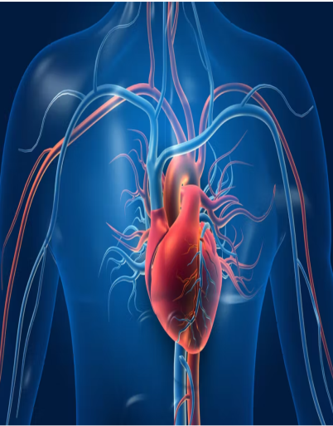
Objective:
Heart disease is one of the leading cause of death among all other disease. The machine learning techniques can be adapted to do the prediction of heart disease.
To use the more accuracy algorithm for prediction by comparing the algorithms
Utilization of suitable technology in this regard can prove to be highly beneficial to the medical fraternity and patients.
Heart Disease Analysis Using Machine Learning
Notes:
What is the project about?
Define the goal of this project
Is it similar to projects in the past or is it a new effort?
Define the scope of this project
Is it an independent project or is it related to other projects?
* Note that this slide is not necessary for weekly status meetings

Slide 4
Problem Statement:
To develop an application for providing prediction of heart related disease using machine learning algorithms.
Input
Heart Disease, BMI, Smoking, Alcohol Drinking, Physical Health, Mental Health, DiffWalking, Sex, Age Category, Race, Diabetic, Physical Activity , GenHealth, Sleep time, Asthma, Kidney Disease, Skin Cancer.
Output
Person gets immediate result based on their inputs along with accuracy so it helps to reduce danger.
Heart Disease Analysis Using Machine Learning

Slide 5
Milestone:
Understanding problem statement
Import necessary Library
Perform EDA
Feature selection
Deployment
Perform models & finalized model
Heart Disease Analysis Using Machine Learning

Slide 6
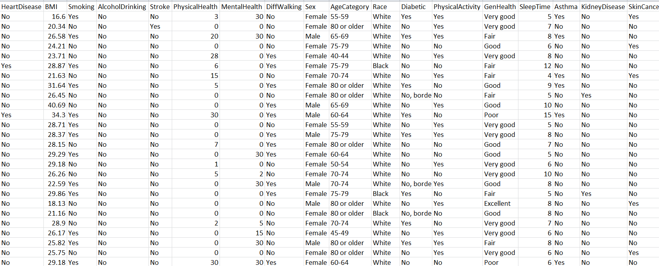
Data set details :
319795 Rows
18 columns
No null values
Heart Disease Analysis Using Machine Learning

Slide 7
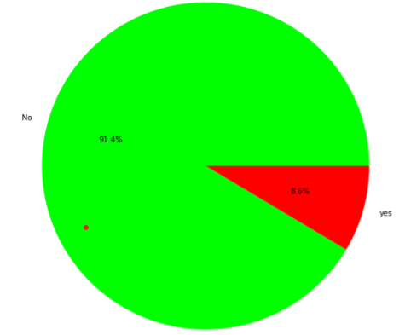
Exploratory Data Analysis:
PIE CHART
The pie chart represents the distribution of the Heart disease in original data.
We can observe here that the class 91.4% of patients don’t have heart disease and 8.6% patients have heart disease.
Heart Disease Analysis Using Machine Learning

Slide 8
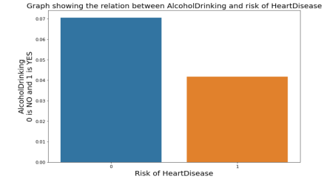
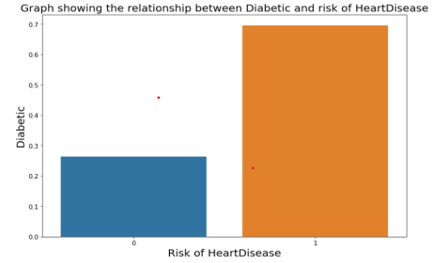
Exploratory Data Analysis:
Relationship between Alcohol Drinking and risk Heart Disease
Relationship between Diabetic and risk of Heart Disease
Heart Disease Analysis Using Machine Learning

Slide 9
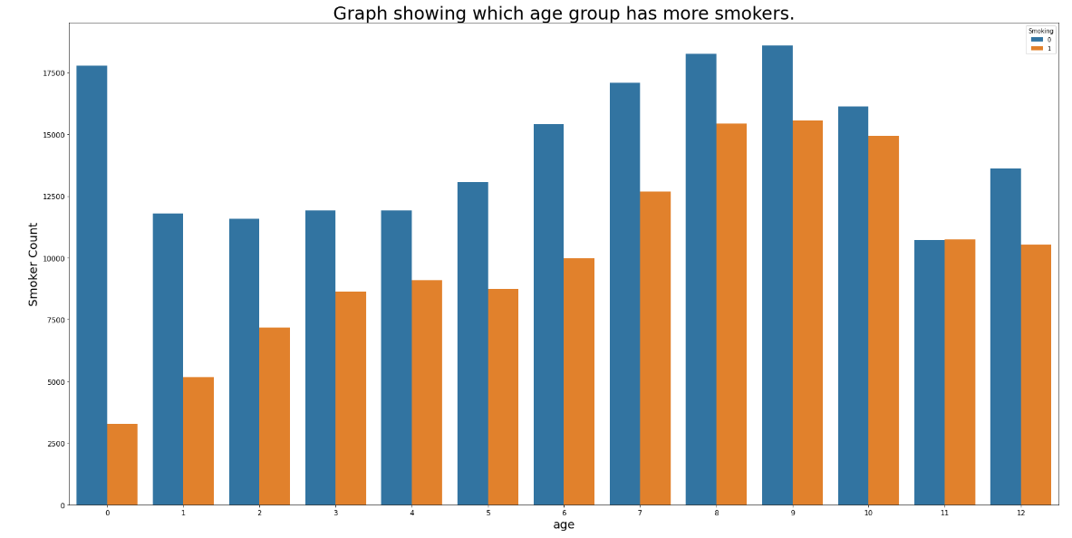
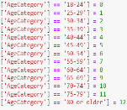
Exploratory Data Analysis:
Heart Disease Analysis Using Machine Learning

Slide 10
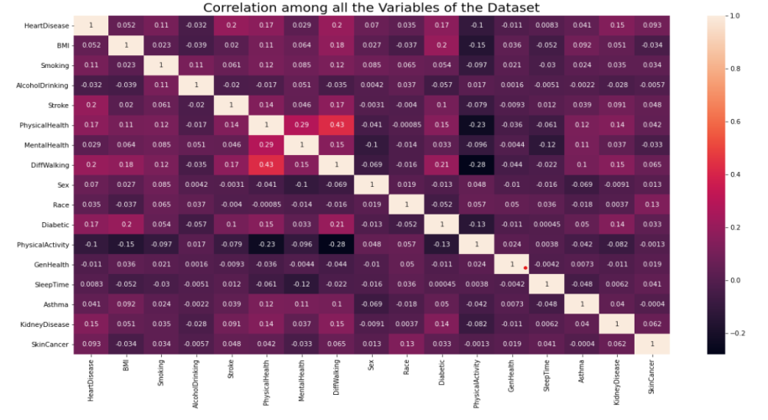
Exploratory Data Analysis:
Heart Disease Analysis Using Machine Learning

Slide 11
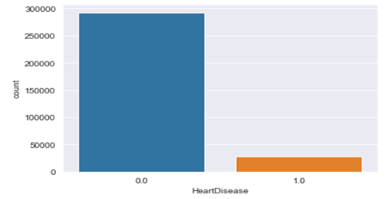
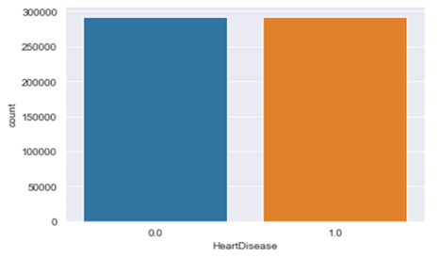
Dealing With Imbalance Data:
Dataset before applying over sampling: Distribution of 1’s and 0’s in target variable
Dataset after applying over sampling: Distribution of 1’s and 0’s in target variable
Heart Disease Analysis Using Machine Learning

Slide 12
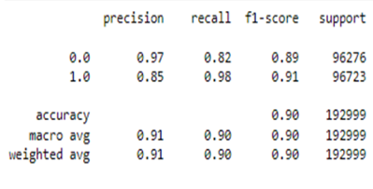
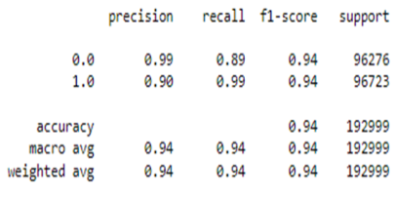
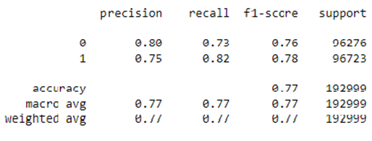
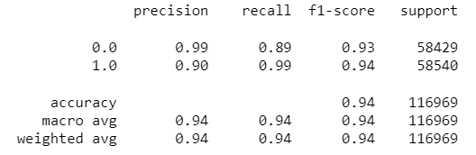
Evaluation of models:
Model Performance: KNN Classifier
Model Performance: Random Forest
Model Performance: XG Boost
Model Performance: Decision Tree
Heart Disease Analysis Using Machine Learning

Slide 13
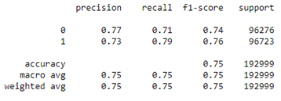
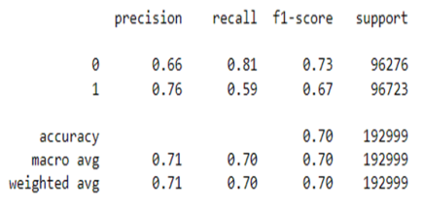
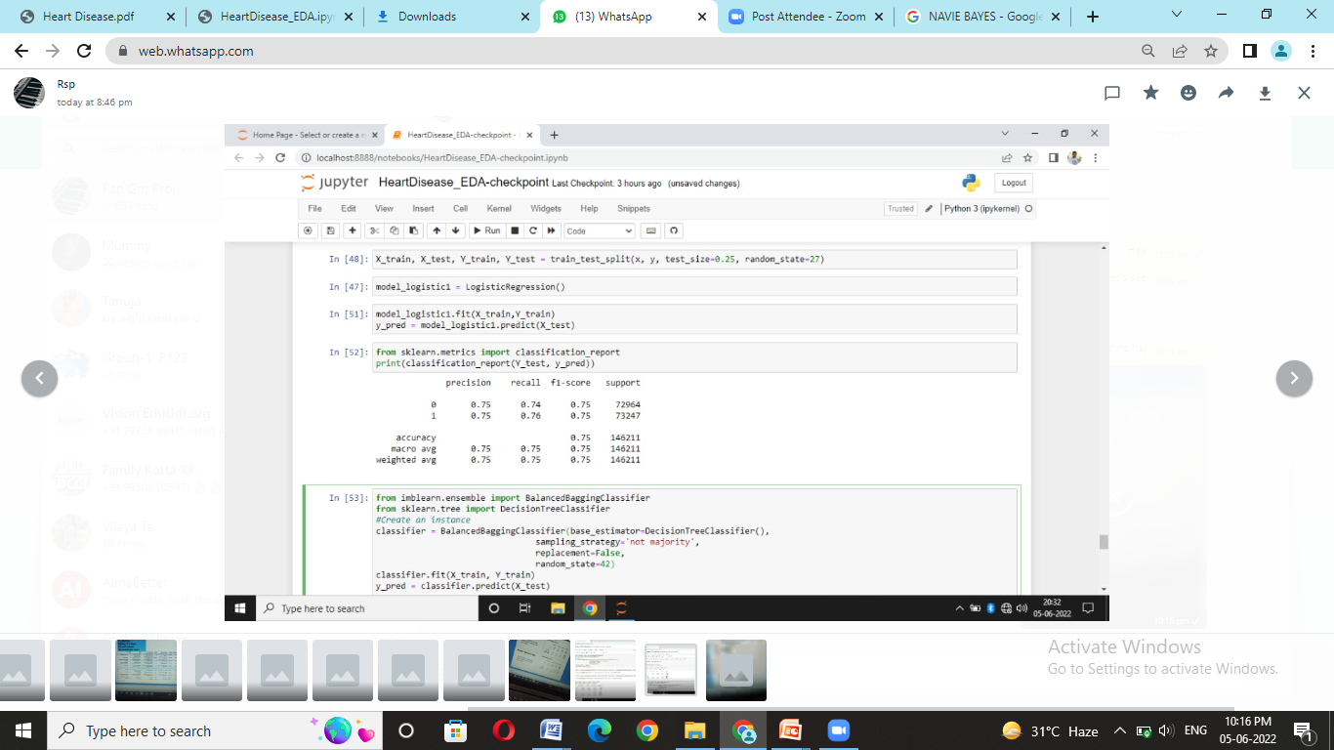
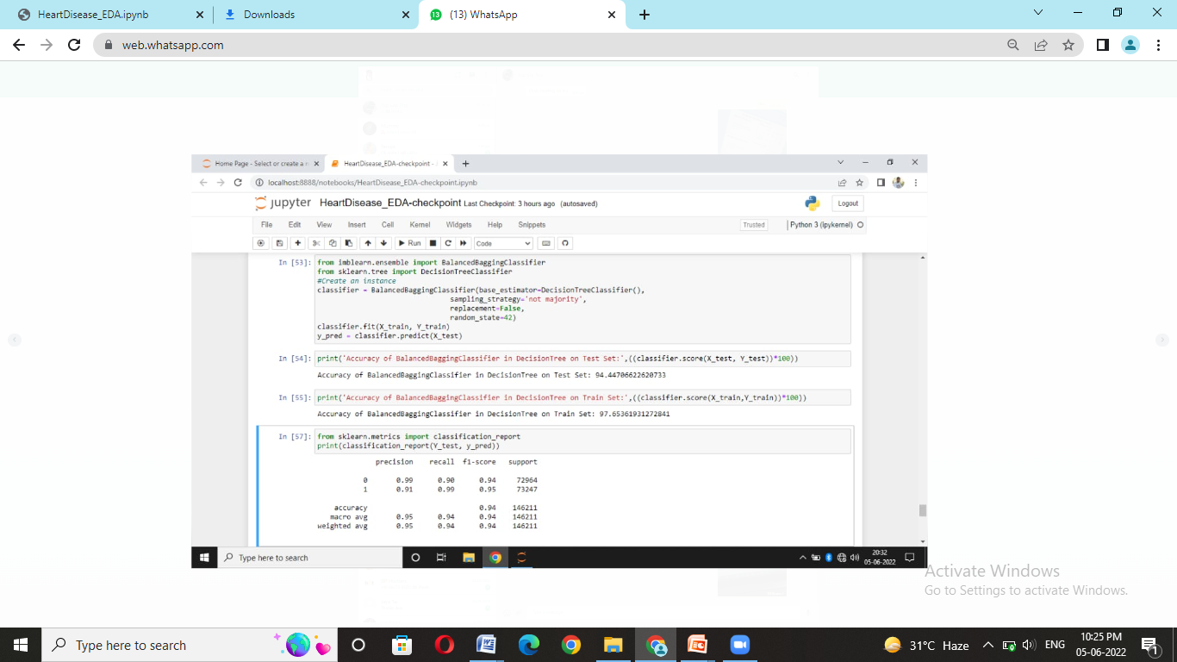
Evaluation of models:
Model Performance: SVC Classifier
Model Performance: Naïve Bayes
Model Performance: Logistic Regression
Model Performance: Balanced Bagging Classifier
Heart Disease Analysis Using Machine Learning

Slide 14
MODEL BUILDING:
All Models with Accuracy
KNN-90%
SVC-75.13%
RANDOM FOREST- 94%
DECISION TREE-94%
XGBOOST-77.29%
BALANCED BAGGING CLASSIFIER-94%
NAIVE BAYES-70.22%
LOGISTIC REGRESSION-75%
Heart Disease Analysis Using Machine Learning
Notes:
What are the dependencies that affect the timeline, cost, and output of this project?

Slide 15
Final Model
Random Forest Classifier With 94% Accuracy
Heart Disease Analysis Using Machine Learning
Notes:
Prepare slides for the appendix in the event that more details or supplemental slides are needed. The appendix is also useful if the presentation is distributed later.

Slide 16
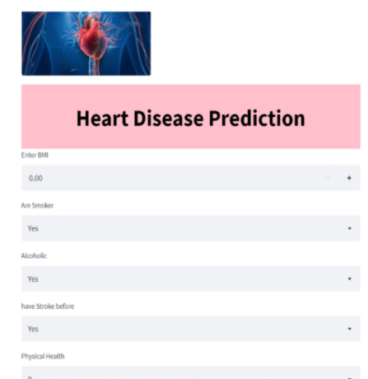
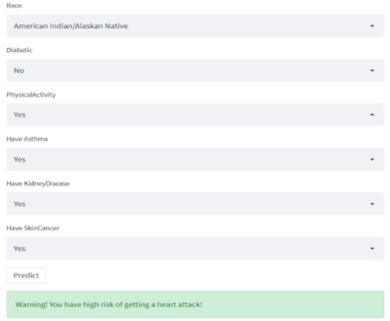
Deployment using Streamlit:
Heart Disease Analysis Using Machine Learning

Slide 17
Challenges:
Requirement of advanced hardware
Time required to run the model
Increase in dataset size
Links:
https://github.com/anujaphapale/Heart-Disease
https://github.com/rahulpanchal9825/HEARTH-DISEASE-PROJECT
https://github.com/sarikazaware/Heart-Disease-Prediction
https://github.com/TANUJAMS/Project1_Heart-Disease-prediction.git
https://github.com/praju07/Heart-Disease-Prediction
Heart Disease Analysis Using Machine Learning

Slide 18
Thank you
Heart Disease Analysis Using Machine Learning

